Slide 1
CS 463 Natural Language Processing
Dr. Saleh Haridy
2022-2023

Slide 2
Week 3
Text Classification and Naive Bayes Classifier

Slide 3
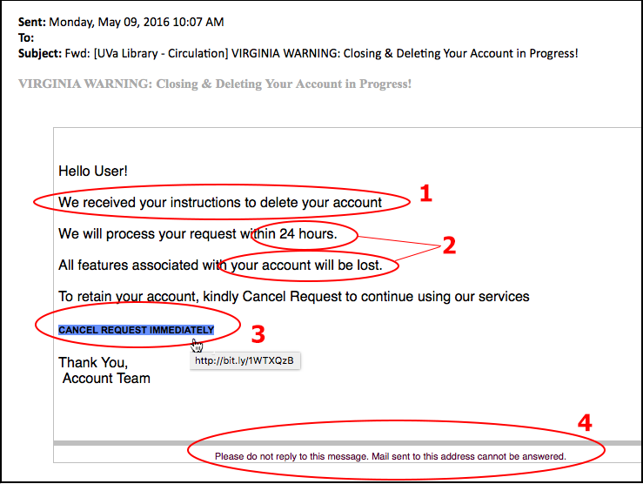
Is this a spam email?

Slide 4
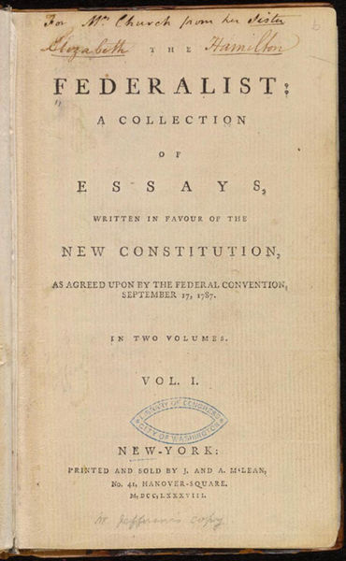
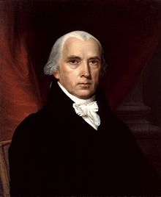

Who wrote this document?
1787-8: anonymous essays try to convince New York to ratify U.S Constitution: Jay, Madison, Hamilton.
Authorship of 12 of the letters in dispute
1963: solved by Mosteller and Wallace using Bayesian methods
James Madison
Alexander Hamilton

Slide 5
What is the subject of this medical article?
Subject Category Hierarchy
MEDLINE Article
Antogonists and Inhibitors
Blood Supply
Chemistry
Drug Therapy
Embryology
Epidemiology
…
?

Slide 6
Positive or negative movie review?
+
...zany characters and richly applied satire, and some great plot twists
It was sad. The worst part about it was the boxing scenes...
...awesome caramel sauce and sweet toasty almonds. I love this place!
...awful pizza and ridiculously overpriced...
−
+
−

Slide 7
Application of Text Classification
Sentiment analysis
Spam detection
Age/gender classification
Authorship identification
Language Identification
Assigning subject categories, topics, or genres
…

Slide 8
Why sentiment analysis?
Movie: is this review positive or negative?
Products: what do people think about the new iPhone?
Politics: what do people think about this candidate or issue?
Prediction: predict market trends from sentiment

Slide 9
Text Classification: definition
Input:
a document d
a fixed set of classes C = {c₁, c₂,…, c_{J}}
Output: a predicted class c ∈ C

Slide 10
Classification Methods: rule-based method
Rules based on combinations of words or other features
spam: black-list-address OR (“dollars” AND “you have been selected”)
Accuracy can be high
If rules carefully refined by expert
But building and maintaining these rules is expensive and time consuming

Slide 11
Classification Methods: Supervised Machine Learning
Input:
a document d
a fixed set of classes C = {c₁, c₂,…, c_{J}}
A training set of m hand-labeled documents (d₁,c₁),....,(d_{m},c_{m})
Output:
a learned classifier γ:d → c

Slide 12
Classification Methods: Supervised Machine Learning
Any kind of classifier
Naïve Bayes
Logistic regression
Neural networks
Support-vector machine (SVM)
k-Nearest Neighbors (KNN)
…

Slide 13
Naive Bayes Intuition
Text Classification and Naive Bayes
Simple ("naive") classification method based on Bayes rule
Relies on very simple representation of document
Bag of words

Slide 14
The Bag of Words Representation

Slide 15


The bag of words representation
seen | 2
sweet | 1
whimsical | 1
recommend | 1
happy | 1
... | ...
f(
)=c

Slide 16
Bayes’ Rule Applied to Documents and Classes
For a document d and a class c

Slide 17
Naive Bayes Classifier (I)
MAP is “maximum a posteriori” = most likely class
Bayes Rule
Dropping the denominator
Drop P(d) because it has same value for all classes
Notes:
p

Slide 18
Naive Bayes Classifier (II)
"Likelihood"
"Prior"
Document d represented as features x1..xn

Slide 19
Naïve Bayes Classifier (IV)
O(|X|^{n}•|C|) parameters
How often does this class occur?
Could only be estimated if a very, very large number of training examples was available.
We can just count the relative frequencies in a corpus

Slide 20
Multinomial Naive Bayes Independence Assumptions
Bag of Words assumption: Assume position doesn’t matter
Conditional Independence: Assume the feature probabilities P(x_{i}|c_{j}) are independent given the class c.

Slide 21
Multinomial Naive Bayes Classifier

Slide 22
Applying Multinomial Naive Bayes Classifiers to Text Classification
positions ← all word positions in test document
Compute the probability for each class
Find the class which has maximum probability

Slide 23
Problems with multiplying lots of probs
There's a problem with this:
Multiplying lots of probabilities can result in floating-point underflow!
.0006 * .0007 * .0009 * .01 * .5 * .000008….
Idea: Use logs, because log(ab) = log(a) + log(b)
We'll sum logs of probabilities instead of multiplying probabilities!

Slide 24
We actually do everything in log space
Instead of this:
This:
Notes:
1) Taking log doesn't change the ranking of classes!
The class with highest probability also has highest log probability!
2) It's a linear model:
Just a max of a sum of weights: a linear function of the inputs
So naive bayes is a linear classifier

Slide 25
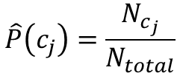
Learning the Multinomial Naive Bayes Model
Sec.13.3
First attempt: maximum likelihood estimates
simply use the frequencies in the data
$$\hat{P}\left(c_{j}\right)=\frac{N_{c_{j}}}{N_{total}}$$
Count number of times word wi occurs in class j
total number of words in class j

Slide 26
Parameter estimation
fraction of times word w_{i} appears
among all words in documents of topic c_{j}
Create mega-document for topic j by concatenating all docs in this topic
Use frequency of w in mega-document

Slide 27
Problem with Maximum Likelihood
What if we have seen no training documents with the word fantastic and classified in the topic positive?
Zero probabilities cannot be conditioned away, no matter the other evidence!

Slide 28
Laplace (add-1) smoothing for Naïve Bayes

Slide 29
Multinomial Naïve Bayes: Learning
From training corpus, extract Vocabulary
Calculate P(c_{j}) terms
For each c_{j} in C do
docs_{j} ← all docs with class =c_{j}
Calculate P(w_{k} | c_{j}) terms
Text_{j} ← single doc containing all docs_{j}
For each word w_{k} in Vocabulary
n_{k} ← # of occurrences of w_{k} in Text_{j}

Slide 30
Unknown words
What about unknown words
that appear in our test data
but not in our training data or vocabulary?
We ignore them
Remove them from the test document!
Pretend they weren't there!
Don't include any probability for them at all!
Why don't we build an unknown word model?
It doesn't help: knowing which class has more unknown words is not generally helpful!

Slide 31
Stop words
Some systems ignore stop words
Stop words: very frequent words like the and a.
Sort the vocabulary by word frequency in training set
Call the top 10 or 50 words the stopword list.
Remove all stop words from both training and test sets
As if they were never there!
But removing stop words doesn't usually help
So in practice most NB algorithms use all words and don't use stopword lists

Slide 32
Let's do a worked sentiment example!

Slide 33
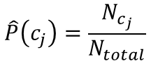
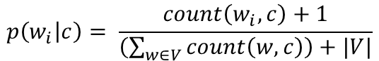
A worked sentiment example with add-1 smoothing
1. Prior from training:
$$\hat{P}\left(c_{j}\right)=\frac{N_{c_{j}}}{N_{total}}$$
P(-) = 3/5
P(+) = 2/5
2. Drop "with"
3. Likelihoods from training:
$$p\left(w_{i} | c\right)= \frac{count\left(w_{i},c\right)+1}{\left(\sum_{w∈V}{count\left(w,c\right)}\right)+|V|}$$
4. Scoring the test set:
Number of words in -ve class= 14
Number of words in +ve class= 9
Total number of words=20

Slide 34
Optimizing for sentiment analysis
For tasks like sentiment, word occurrence seems to be more important than word frequency (how many times occured).
The occurrence of the word fantastic tells us a lot
The fact that it occurs 5 times may not tell us much more.
Binary multinominal naive bayes, or binary NB
Clip our word counts at 1

Slide 35
Binary Multinomial Naïve Bayes: Learning
From training corpus, extract Vocabulary
Calculate P(c_{j}) terms
For each c_{j} in C do
docs_{j} ← all docs with class =c_{j}
Calculate P(w_{k} | c_{j}) terms
Remove duplicates in each doc:
For each word type w in doc_{j}
Retain only a single instance of w
Text_{j} ← single doc containing all docs_{j}
For each word w_{k} in Vocabulary
n_{k} ← # of occurrences of w_{k} in Text_{j}

Slide 36
Binary Multinomial Naive Bayes on a test document d
First remove all duplicate words from d
Then compute NB using the same equation:

Slide 37
Binary multinominal naive Bayes
Counts can still be 2! Binarization is within-doc!

Slide 38
Sentiment Classification: Dealing with Negation
I really like this movie
I really don't like this movie
Negation changes the meaning of "like" to negative.
Negation can also change negative to positive-ish
Don't dismiss this film
Doesn't let us get bored

Slide 39
Sentiment Classification: Dealing with Negation
Das, Sanjiv and Mike Chen. 2001. Yahoo! for Amazon: Extracting market sentiment from stock message boards. In Proceedings of the Asia Pacific Finance Association Annual Conference (APFA).
Bo Pang, Lillian Lee, and Shivakumar Vaithyanathan. 2002. Thumbs up? Sentiment Classification using Machine Learning Techniques. EMNLP-2002, 79—86.
Simple baseline method:
Add NOT_ to every word between negation and following punctuation:
didn’t like this movie , but I
didn’t NOT_like NOT_this NOT_movie but I

Slide 40
Sentiment Classification: Lexicons
Sometimes we don't have enough labeled training data
In that case, we can make use of pre-built word lists
Called lexicons
There are various publically available lexicons

Slide 41
MPQA Subjectivity Cues Lexicon
Theresa Wilson, Janyce Wiebe, and Paul Hoffmann (2005). Recognizing Contextual Polarity in
Phrase-Level Sentiment Analysis. Proc. of HLT-EMNLP-2005.
Riloff and Wiebe (2003). Learning extraction patterns for subjective expressions. EMNLP-2003.
Home page: https://mpqa.cs.pitt.edu/lexicons/subj_lexicon/
6885 words from 8221 lemmas, annotated for intensity (strong/weak)
2718 positive
4912 negative
+ : admirable, beautiful, confident, dazzling, ecstatic, favor, glee, great
− : awful, bad, bias, catastrophe, cheat, deny, envious, foul, harsh, hate

Slide 42
The General Inquirer
Philip J. Stone, Dexter C Dunphy, Marshall S. Smith, Daniel M. Ogilvie. 1966. The General Inquirer: A Computer Approach to Content Analysis. MIT Press
Home page: http://www.wjh.harvard.edu/~inquirer
List of Categories: http://www.wjh.harvard.edu/~inquirer/homecat.htm
Spreadsheet: http://www.wjh.harvard.edu/~inquirer/inquirerbasic.xls
Categories:
Positiv (1915 words) and Negativ (2291 words)
Strong vs Weak, Active vs Passive, Overstated versus Understated
Pleasure, Pain, Virtue, Vice, Motivation, Cognitive Orientation, etc
Free for Research Use

Slide 43
Using Lexicons in Sentiment Classification
Add a feature that gets a count whenever a word from the lexicon occurs
E.g., a feature called "this word occurs in the positive lexicon" or "this word occurs in the negative lexicon"
Now all positive words (good, great, beautiful, wonderful) or negative words count for that feature.
Using 1-2 features isn't as good as using all the words.
But when training data is sparse or not representative of the test set, dense lexicon features can help

Slide 44
Naive Bayes in Other tasks: Spam Filtering
SpamAssassin Features:
Mentions millions of (dollar) ((dollar) NN,NNN,NNN.NN)
From: starts with many numbers
Subject is all capitals
HTML has a low ratio of text to image area
"One hundred percent guaranteed"
Claims you can be removed from the list

Slide 45
Naive Bayes in Language ID
Determining what language a piece of text is written in.
Features based on character n-grams do very well
Important to train on lots of varieties of each language
(e.g., American English varieties like African-American English, or English varieties around the world like Indian English)

Slide 46
Summary: Naive Bayes is Not So Naive
Very Fast, low storage requirements
Work well with very small amounts of training data
Robust to Irrelevant Features
Irrelevant Features cancel each other without affecting results
Very good in domains with many equally important features
Decision Trees suffer from fragmentation in such cases – especially if little data
Optimal if the independence assumptions hold: If assumed independence is correct, then it is the Bayes Optimal Classifier for problem
A good dependable baseline for text classification
But we will see other classifiers that give better accuracy

Slide 47
Generative Model for Multinomial Naïve Bayes
Naïve Bayes: Relationship to Language Modeling
c=+
X₁=I
X₂=love
X₃=this
X₄=fun
X₅=film

Slide 48
Naïve Bayes and Language Modeling
Naïve bayes classifiers can use any sort of feature
URL, email address, dictionaries, network features
But if, as in the previous slides
We use only word features
we use all of the words in the text (not a subset)
Then
Naive bayes has an important similarity to language modeling.

Slide 49
Each class = a unigram language model
Sec.13.2.1
Assigning each word: P(word | c)
Assigning each sentence: P(s|c)=Π P(word|c)
Class pos
0.1 I
0.1 love
0.01 this
0.05 fun
0.1 film
…
I
love
this
fun
film
0.1
0.1
.05
0.01
0.1
P(s | pos) = 0.0000005

Slide 50
Naïve Bayes as a Language Model
Sec.13.2.1
Which class assigns the higher probability to a document s?
Model pos
Model neg
0.1 I
0.1 love
0.01 this
0.05 fun
0.1 film
0.2 I
0.001 love
0.01 this
0.005 fun
0.1 film
I
love
this
fun
film
0.1
0.1
0.01
0.05
0.1
0.2
0.001
0.01
0.005
0.1
P(s|pos) > P(s|neg)

Slide 51
Evaluation
Let's consider just binary text classification tasks
Imagine you're the CEO of Delicious PIZZA Company
You want to know what people are saying about your PIZZA
So you build a "Delicious PIZZA " tweet detector
Positive class: tweets about Delicious PIZZA Co
Negative class: all other tweets

Slide 52
The 2-by-2 confusion matrix
Actual Label
Actual Positive
Actual Negative

Slide 53
Evaluation: Accuracy
Why don't we use accuracy as our metric?
Imagine we saw 1 million tweets
100 of them talked about Delicious PIZZA Co.
999,900 talked about something else
We could build a dumb classifier that just labels every tweet "not about PIZZA"
It would get 99.99% accuracy!!! Wow!!!!
But useless! Doesn't return the comments we are looking for!
That's why we use precision and recall instead

Slide 54
Evaluation: Precision
% of items actually present in the input that were correctly identified by the system.

Slide 55
Evaluation: Recall
% of items the system detected (i.e., items the system labeled as positive) that are in fact positive (according to the correct labels)

Slide 56
Why Precision and recall
Our dumb PIZZA-classifier
Just label nothing as "about PIZZA"
Accuracy=99.99%
but
Recall = 0
(it doesn't get any of the 100 PIZZA tweets)
Precision and recall, unlike accuracy, emphasize true positives:
finding the things that we are supposed to be looking for.

Slide 57
A combined measure: F
F measure: a single number that combines P and R:
We almost always use balanced F₁ (i.e., β = 1)

Slide 58
Development Test Sets ("Devsets") and Cross-validation
Train on training set, tune on devset, report on testset
This avoids overfitting (‘tuning to the test set’)
More conservative estimate of performance
But paradox: want as much data as possible for training, and as much for dev; how to split?
Training set
Development Test Set
Test Set

Slide 59
Cross-validation: multiple splits
Pool results over splits, Compute pooled dev performance

Slide 60
Confusion Matrix for 3-class classification

Slide 61
How to combine P/R from 3 classes to get one metric
Macroaveraging:
compute the performance for each class, and then average over classes
Microaveraging:
collect decisions for all classes into one confusion matrix
compute precision and recall from that table.

Slide 62
Macroaveraging and Microaveraging

